Slide 1
DC Power Supply
Under the supervision of Dr.Sherif Hekal
Eng.Sara Adel

Slide 2
Our Team
Abdelrahman Salah el-dein Abdelaziz
Mohamed Ahmed Mohamed Hassan
Farida Waheed Abd El Bary
Raneem Ahmed Refaat

Slide 3
AIM OF THE PROJECT
It is to construct an adjustable regulated power supply that can provide DC voltage ranging from 1.2-30V. As the electric circuit consists of an AC Transformer followed by a rectifier bridge then smoothing capacitor and an adjustable voltage regulator integrated circuit.

Slide 4
PROJECT STAGES
STEP 2
STEP 1
STEP 3
Put our circuit on one of the simulator programs which is proteus to check it.
Design the project by select the components and choose suitable values for them.
Then we start the practical process.

Slide 5
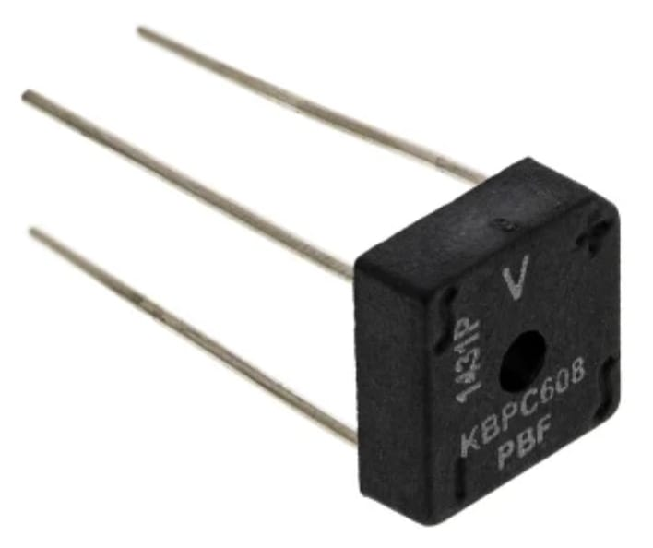
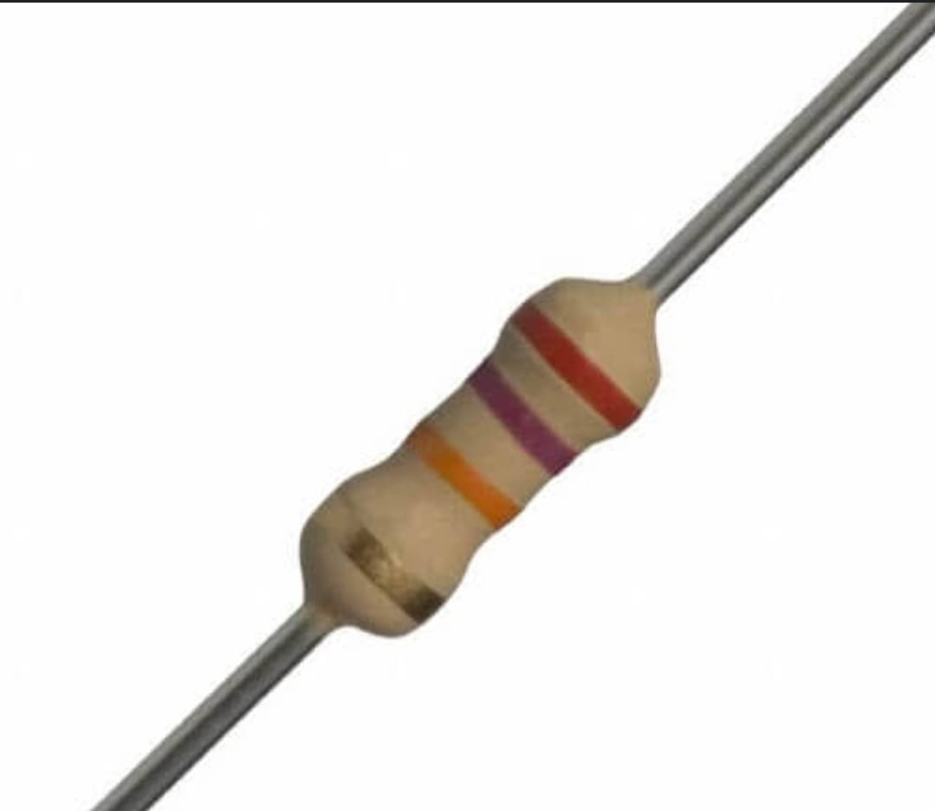
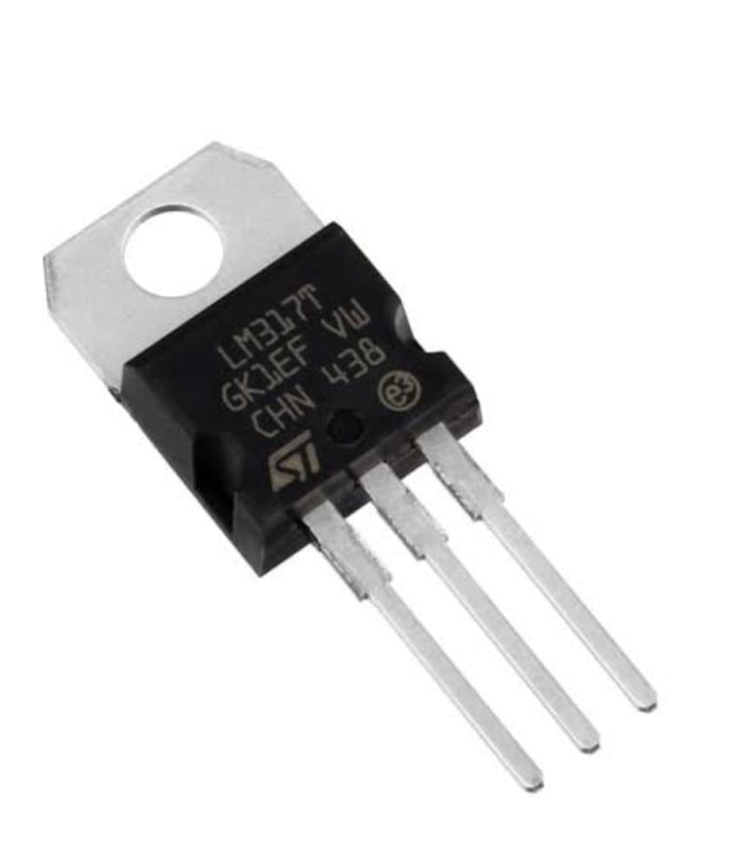
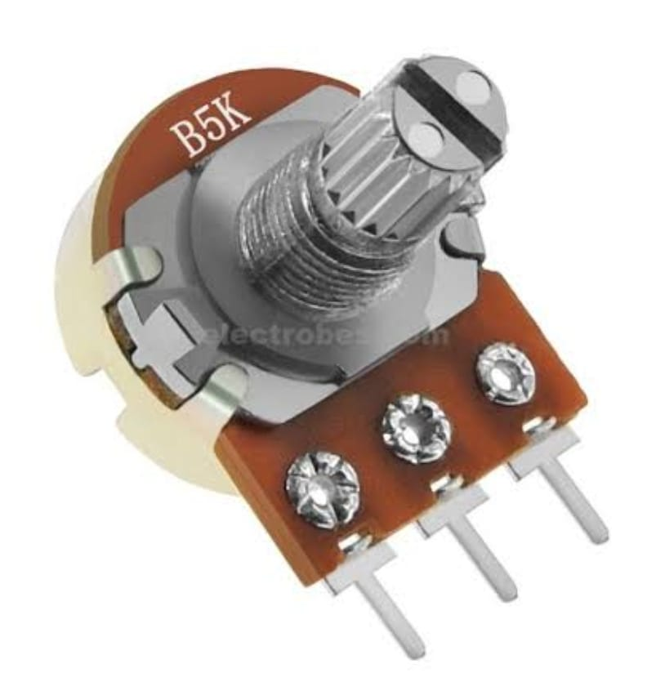
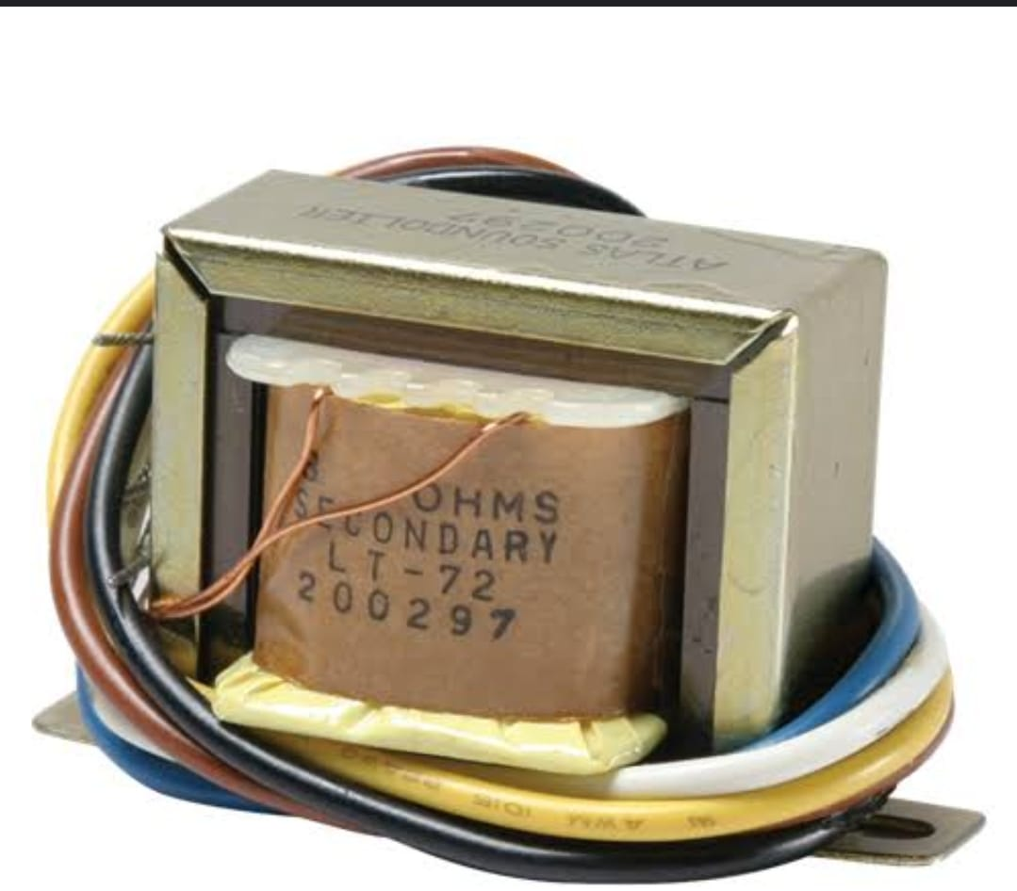
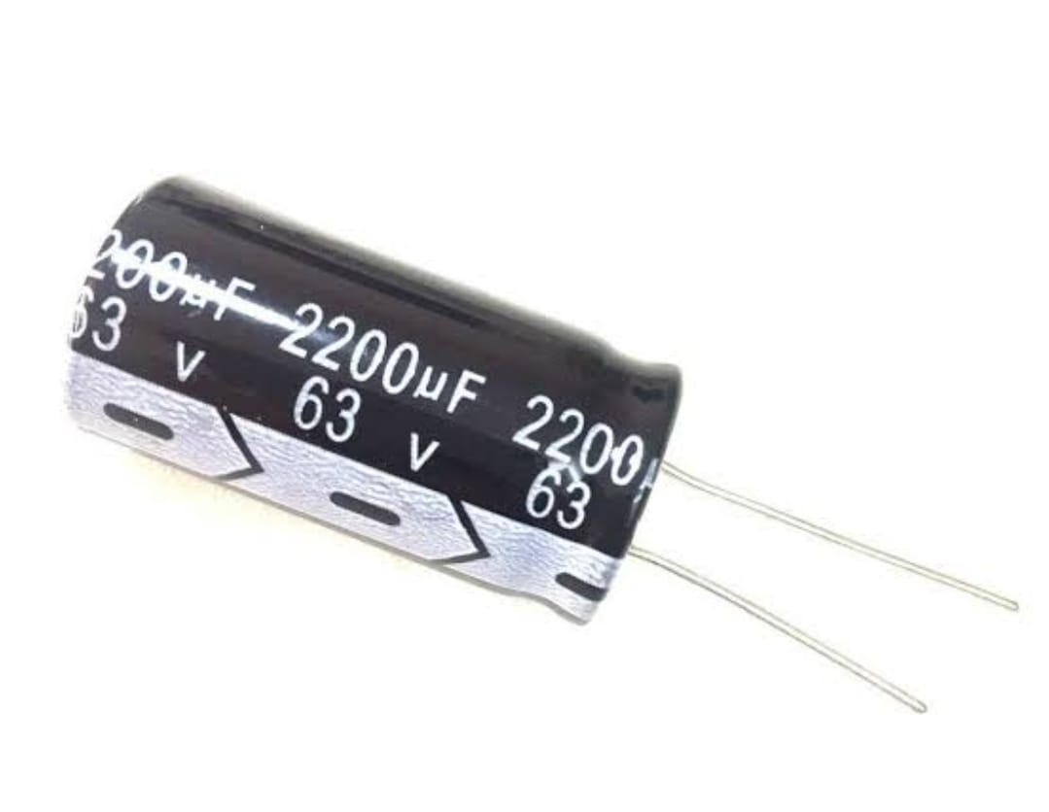
TABLE OF COMPONENTS
01
04
Bridge Rectifier
Resistor
02
05
Adjustable Voltage Regulator
Potentiometer
03
06
Transformer
Capacitor
It’s value and number used in the project: 100V-3A , 1 Bridge
It’s value and number used in the project: 18K,220 with 5% , 2 Resistors
It’s value and number used in the project: 1.2V-37V , 1 LM317
It’s value and number used in the project: 5K , 1 Potentiometer
It’s value and number used in the project: 24V-3A , 1 Transformer
It’s value and number used in the project: 2200micro-farad , 0.1micro-farad , 1micro-farad , 40V , 3 Capacitors

Slide 6
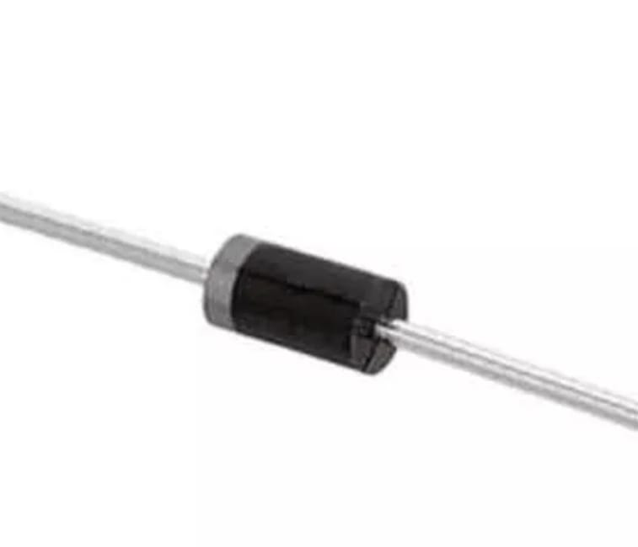
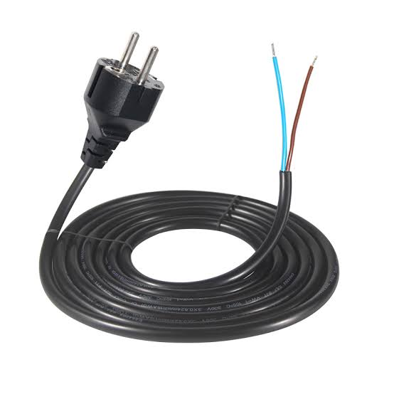
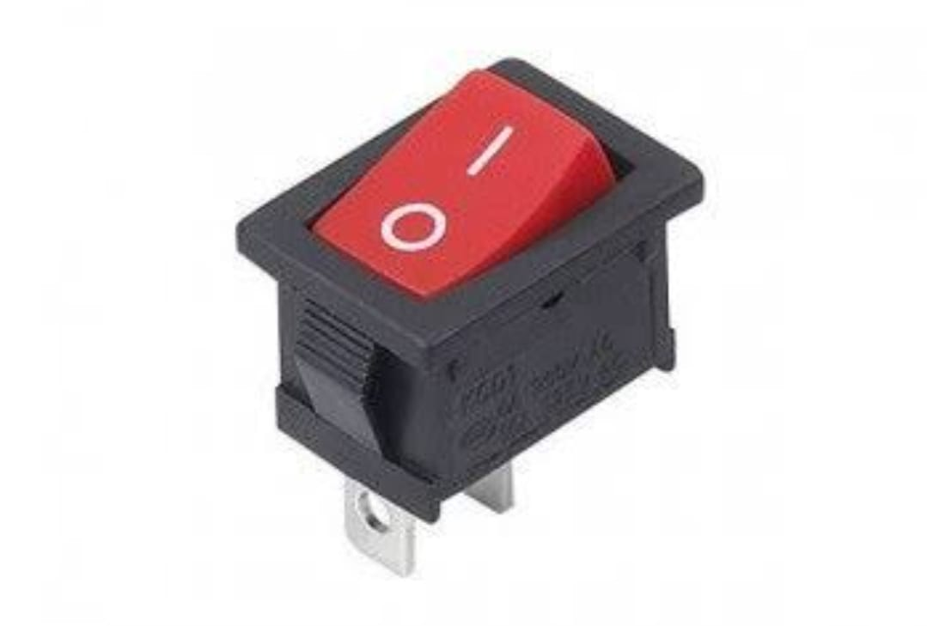
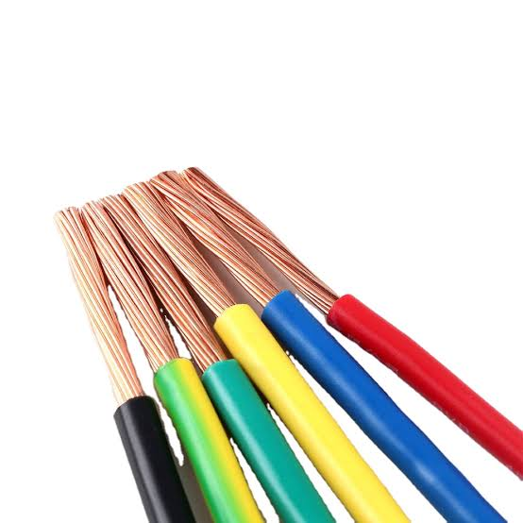
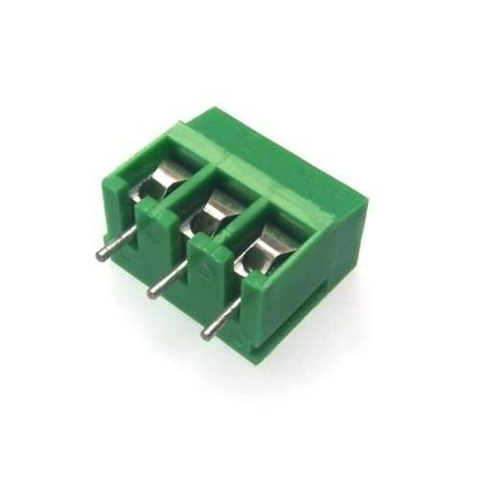
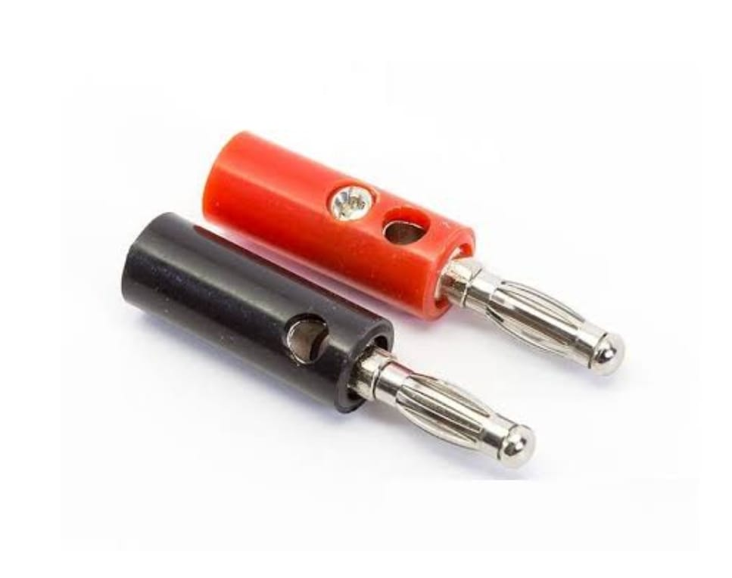
TABLE OF COMPONENTS
07
10
Diode
Plug
08
11
Switch
Wires
09
12
Banana Plug Connectors
Connectors
It’s value and number used in the project: 400V,1A , 1 Diode
Its type: 2 Wire plug & Cord
It’s type: ON/OFF Rocker Switch
It’s color: Red and Black

Slide 7
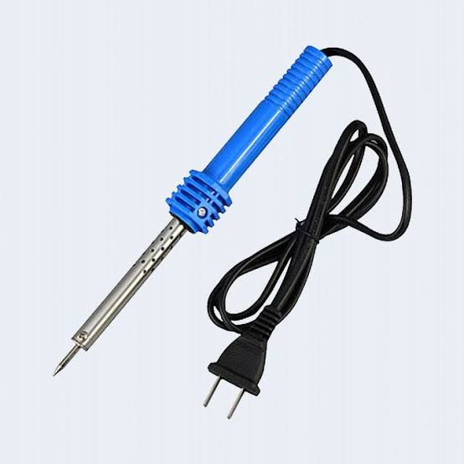
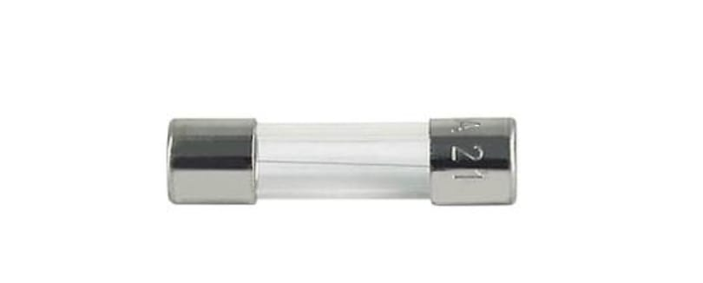
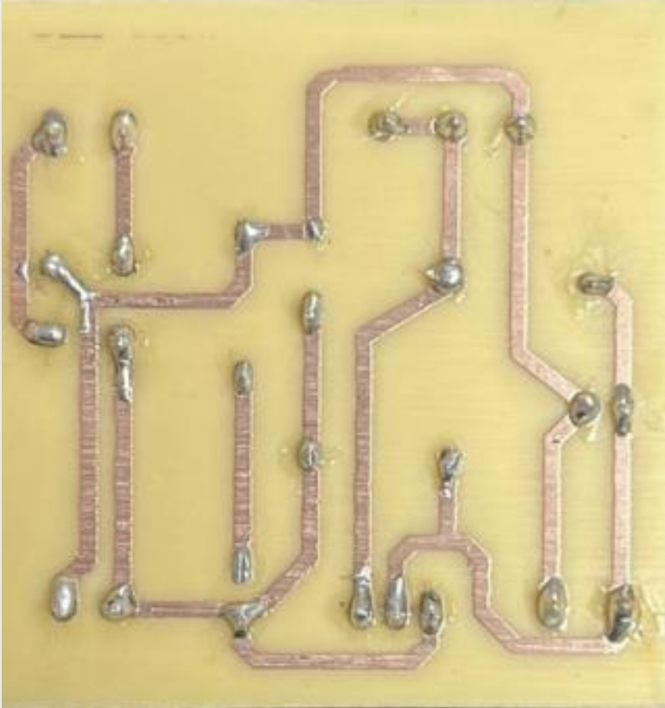
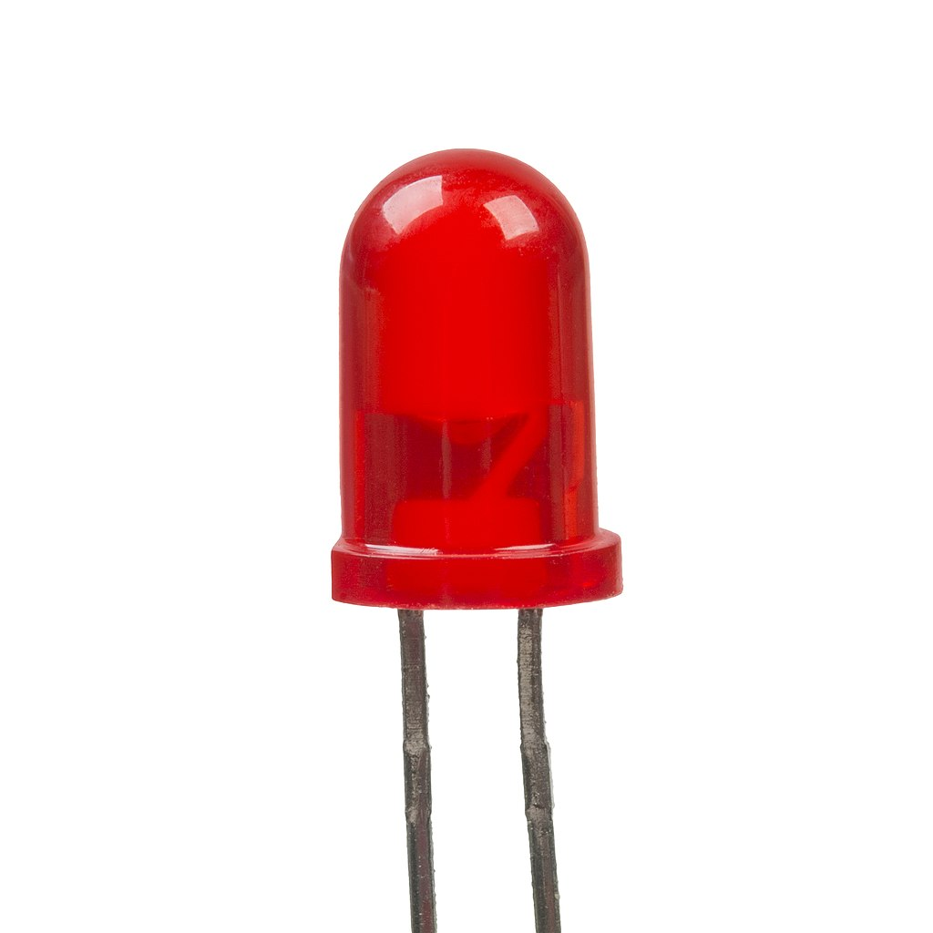
TABLE OF COMPONENTS
13
15
Soldering Iron
Fuse
14
16
LED
PCB Board
It’s color: Red

Slide 8
SMALL HINT ON EACH COMPONENT
Bridge Rectifier
Adjustable Voltage Regulator
Transformer
It is a convertor that convert the Alternating Current (AC) to Direct Current (DC).
It is a regulator that can output adjustable voltages from anywhere in the range that the voltage regulator is designed to output.
It is basically a voltage control device that’s used widely in the distribution and transmission of alternating current power.

Slide 9
SMALL HINT ON EACH COMPONENT
Resistor
Potentiometer
Capacitor
A passive electrical component with two-terminals that are used for limiting the flow of electric current in electrical circuits.
A passive electrical component with three-terminal resistor with a rotating contact that forms an adjustable voltage divider.
It is passive electronic component and has the capacity to store energy in the form of an electrical charge.

Slide 10
SMALL HINT ON EACH COMPONENT
Diode
Switch
Connector
It is a semiconductor device that essentially acts as a one-way switch for current which allows current to flow easily in one direction.
A device that opens and closes an electric circuit.
A connector is a device that joins two pieces of equipment, wire, or piping together

Slide 11
SMALL HINT ON EACH COMPONENT
Plug
Wires
Banana Plug Connector
It connects electric equipment to the alternating current (AC) power supply in buildings and on other sites.
A power cord is an electrical component used for connecting appliances to an electrical utility or power supply.
They are electrical connectors that are used to join single-conductor wires to each other or to pieces of equipment.

Slide 12
SMALL HINT ON EACH COMPONENT
Soldering Iron
LED
PCB
It is a hand tool used in soldering. It supplies heat to melt solder so that it can flow into the joint between two workpieces.
It is a semiconductor device that emits light when current flows through it.
It is a medium used in electrical and electronic engineering to connect electronic components to one another in a controlled manner.

Slide 13
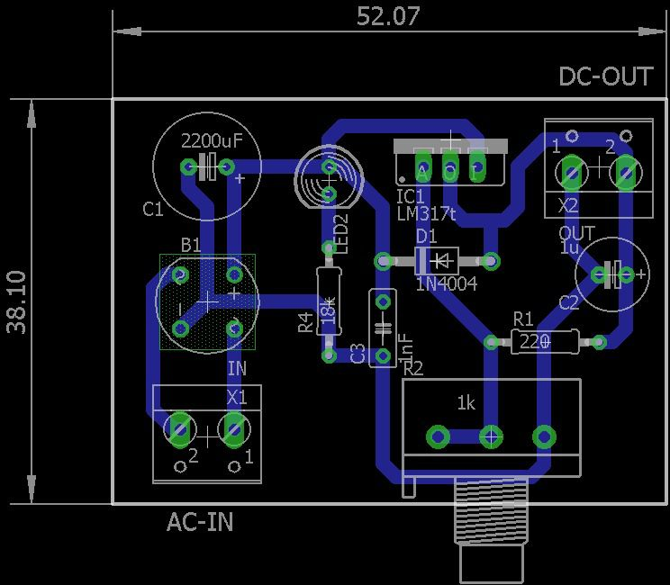
THE DESIGN ON PCB
After we designed the circuit, and put it on the simulator program (proteus) it gave us voltage ranging from 1.25V to 29.9V.
So, we went on and printed our design on the PCB.

Slide 14
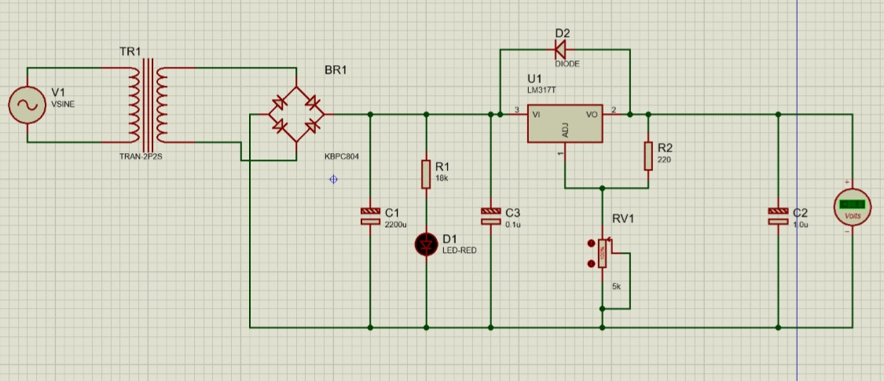
THE DESIGN ON PROTEUS

Slide 15
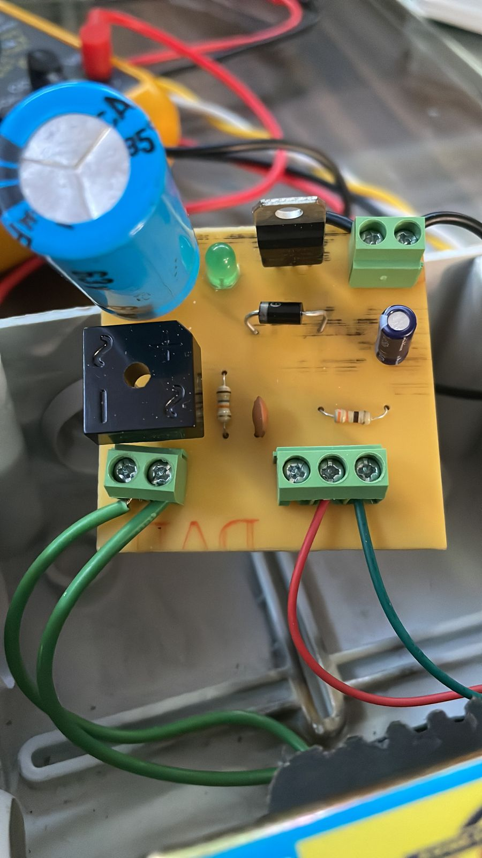
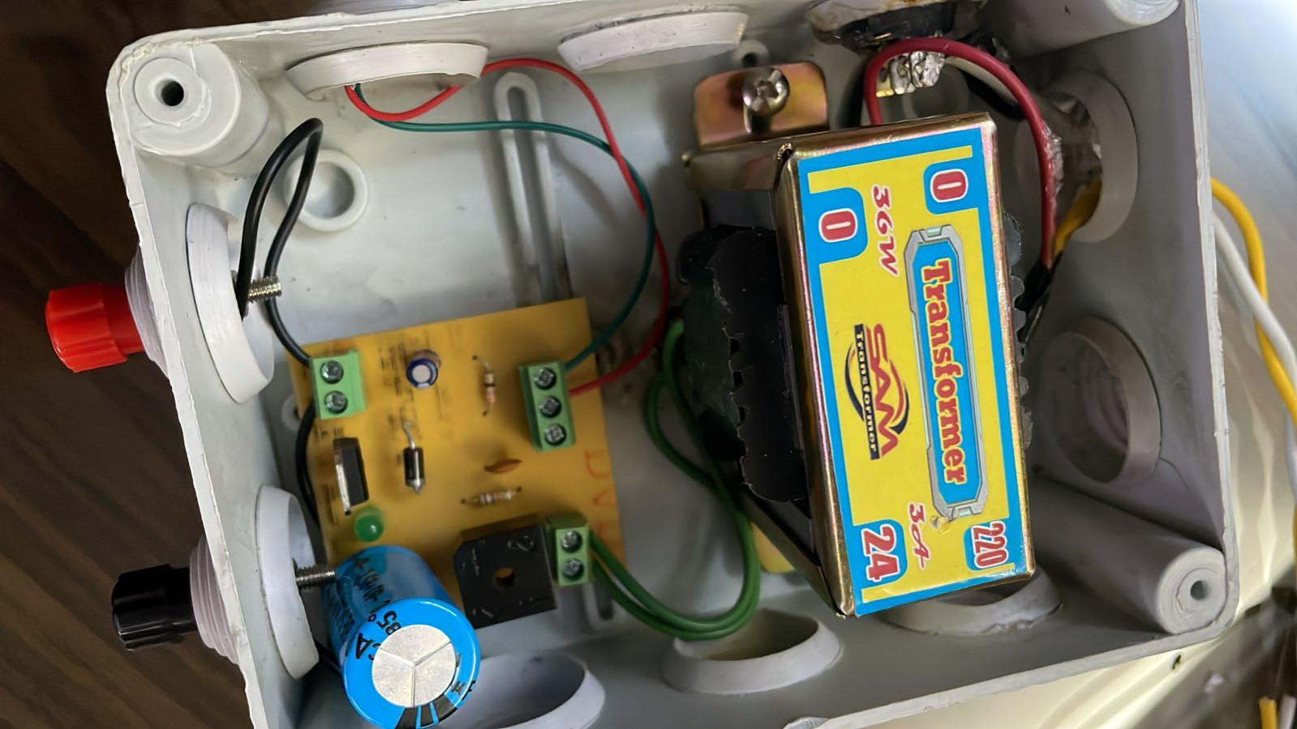
AFTER THAT
We went on and buy our components.
Then we joined the components together on the PCB using soldering iron.
Then plugged it in the plug to a power source, opened the switch.
We checked the voltage using digital multimeter (AVO) it gave us a voltage ranging from 1.2V to 31.5 V.

Slide 16
THANK YOU!

